Slide 1
Creative and Innovative Project:
Optical Character Recogniser and Translator
Kevin Paul -- 2018115049
Srijeyarankesh -- 2018115109
Vishwa Kumar -- 2018115134

Slide 2
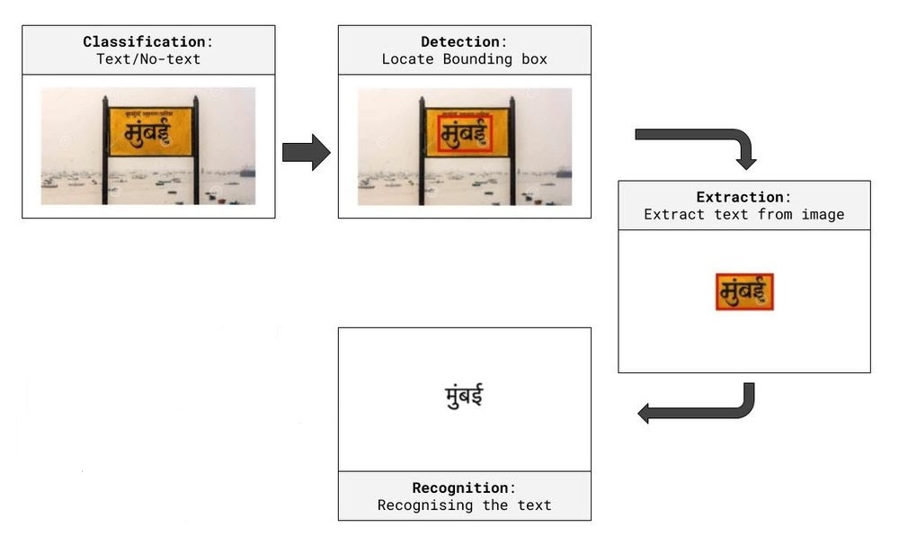
Aim: To create a user interactive application where a user can send a picture with text characters of Indian languages and text characters are recognised. The entire model is embedded as a web application.

Slide 3
Work Done: (So Far)
Massive dataset collected over various images with Hindi Indic text present on them.
Finalised the algorithms and architectures to be used for detection and recognition.
Detection - CRAFT Algorithm
Recognition - CRNN (Resnet,VGGnet , LSTM and CTC loss function.)

Slide 4
How algorithm aims to work: (Images)
CRAFT Algorithm - CRAFT text detector that effectively detect text area by exploring each character region and affinity between characters.

Slide 5
Work yet to do:
Identification of Hindi text in images using Advanced Updated OCR which detects text in its native Hindi and also creates boundary boxes accordingly.
Testing and training the model further to build up on accuracy of model to detect and produce the correct results of the text detected.
A user based application as well where users can feed images so our model can detect the text to provide the translated version.
Furnishing our end product to its highest ability for best user experience.

Slide 6
End of Presentation.
Thank you for your patience

